Slide 1
1.5 compression

Slide 2
Objective
show understanding of how digital data can be compressed, using either ‘lossless’ (including run-length encoding – RLE) or ‘lossy’ techniques

Slide 3
Lossless compression
Lossless compression - compression doesn't lose any information and can be decompressed into an identical copy of the original file
There are lossless compressed file formats out there such as FLAC which compress the WAV file into data generally 50% the original size.

Slide 4
run length encoding 行程编码
Looks for repeated patterns in the file, and instead of recording each pattern separately, it stores information on how many times the pattern occurs in a row.
For example:
0000 0000 0000 0000 0000 0123 4543 2100 0000 0000 0000 0000 0123 4567 8765 6789 876
the silent area takes up a large part of the file, instead of recording these individually we can set data to state how many silent samples there are in a row, massively reducing the file size:
(21-0)123454321(17-0)123456787656789876

Slide 5
Exercise
perform run length encoding on the following sound file
012344444444444432222222222222211111111111111000000000000

Slide 6
Lossy compression
Lossy compression - compression loses the file accuracy, generally smaller than lossless compression, it can not be decompressed into the original file
To make smaller audio files we can decrease the sampling rate and the sampling resolution,
There are other clever methods of compressing sounds
Some of the data may be removed.
Remove visual or audio data least likely to be noticed by a human

Slide 7
human hearing：20Hz~20kHz
We have seen the various ways that you can reduce the size of files, we have also seen that humans have a limit to the frequencies.
The full range of human hearing is between 20 Hz and 20 kHz.

Slide 8
Nyquist's theorem
Nyquist's theorem - The frequency of sampling should be at least twice the highest frequency in the signal.
  Therefore the minimum sampling rate that satisfies the sampling for the human ear is 40 kHz (2*20kHz).
  The 44.1 kHz sampling rate used for Compact Disc was chosen for this and other technical reasons.

Slide 9
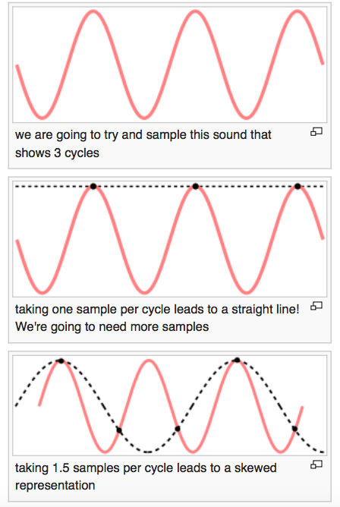
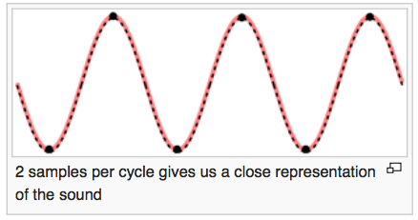

Slide 10
calculate the sample rate：
  Work out the period by looking at the time taken for one circle.
  Work out the frequency
  Work out the sample rate with this:
    sample rate=2*freqency(f)

Slide 11
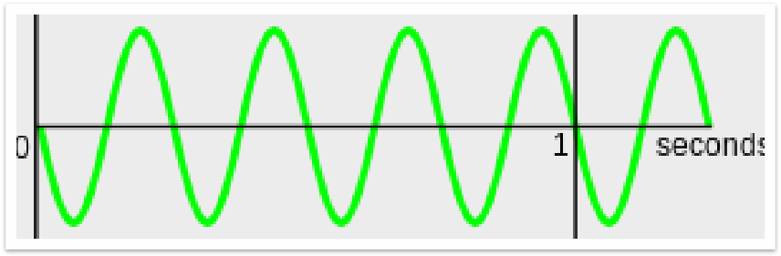
Exercise
How many cycles per second in the following sample?
What should the sample rate be according to Nyquist's-theorem for the sample shown below?

